Slide 1

Multivariable Optimization: Numerical Techniques
MTH 564 – Mathematical Modeling

Slide 2
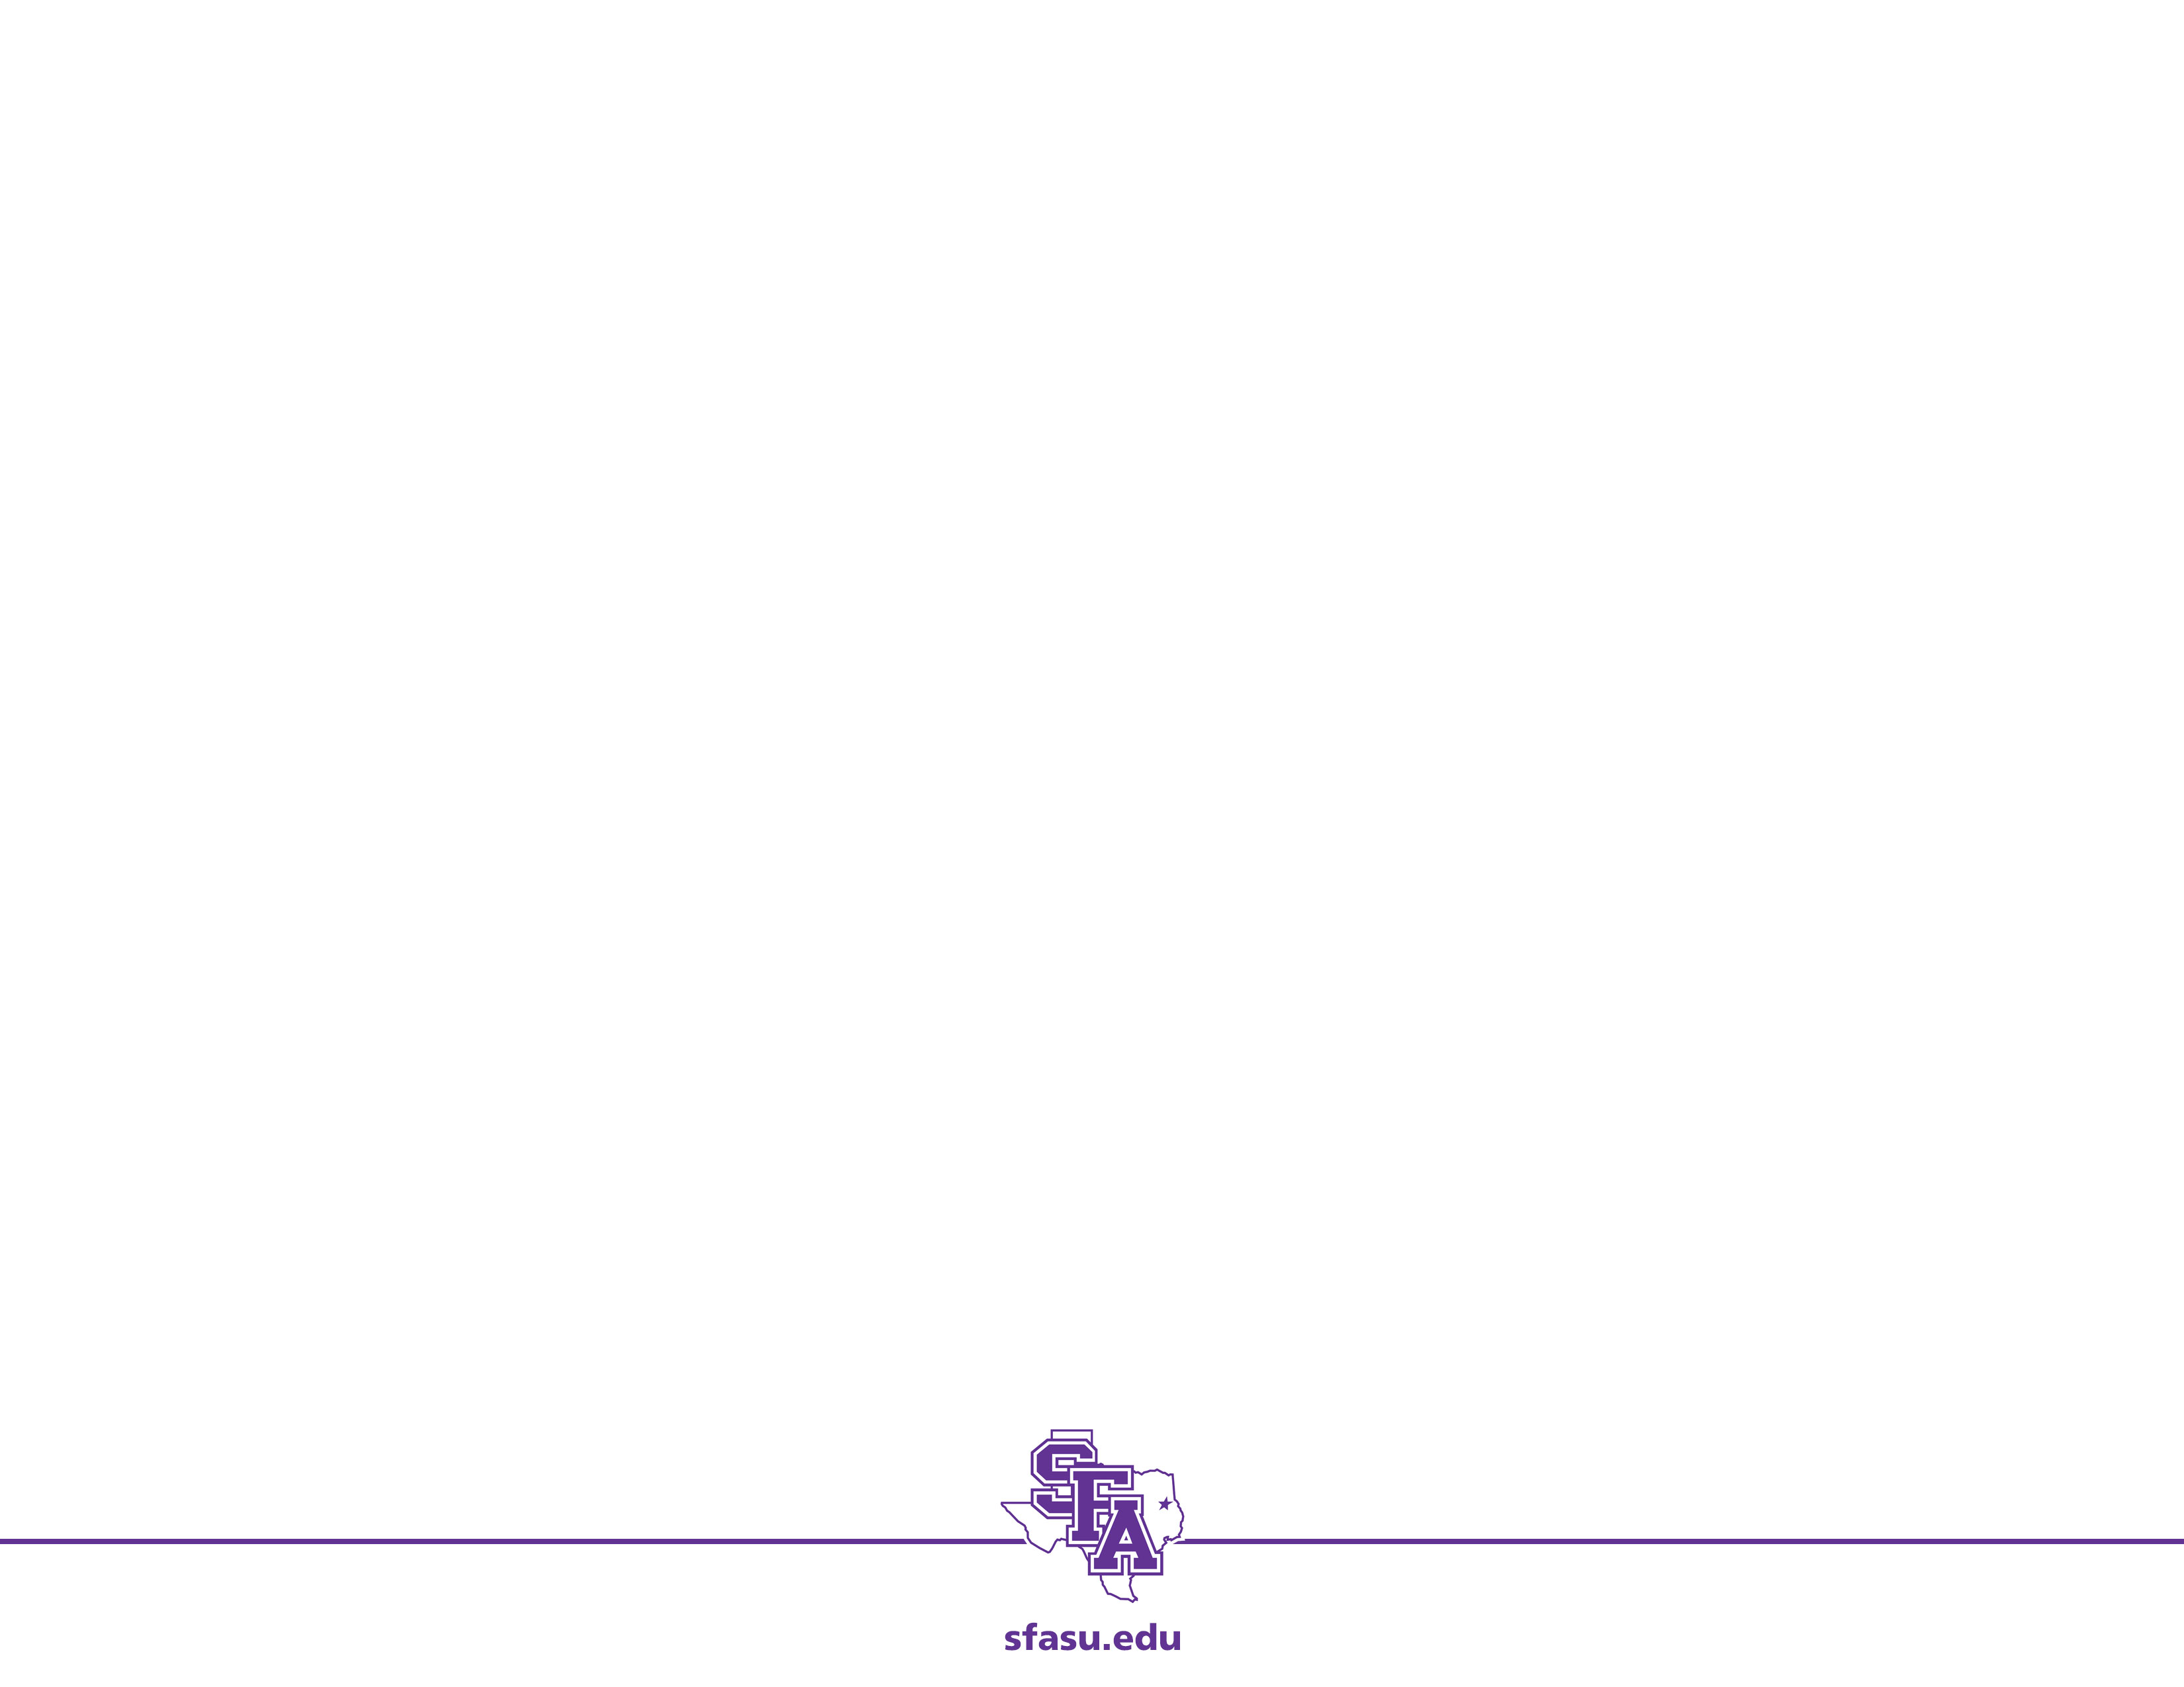
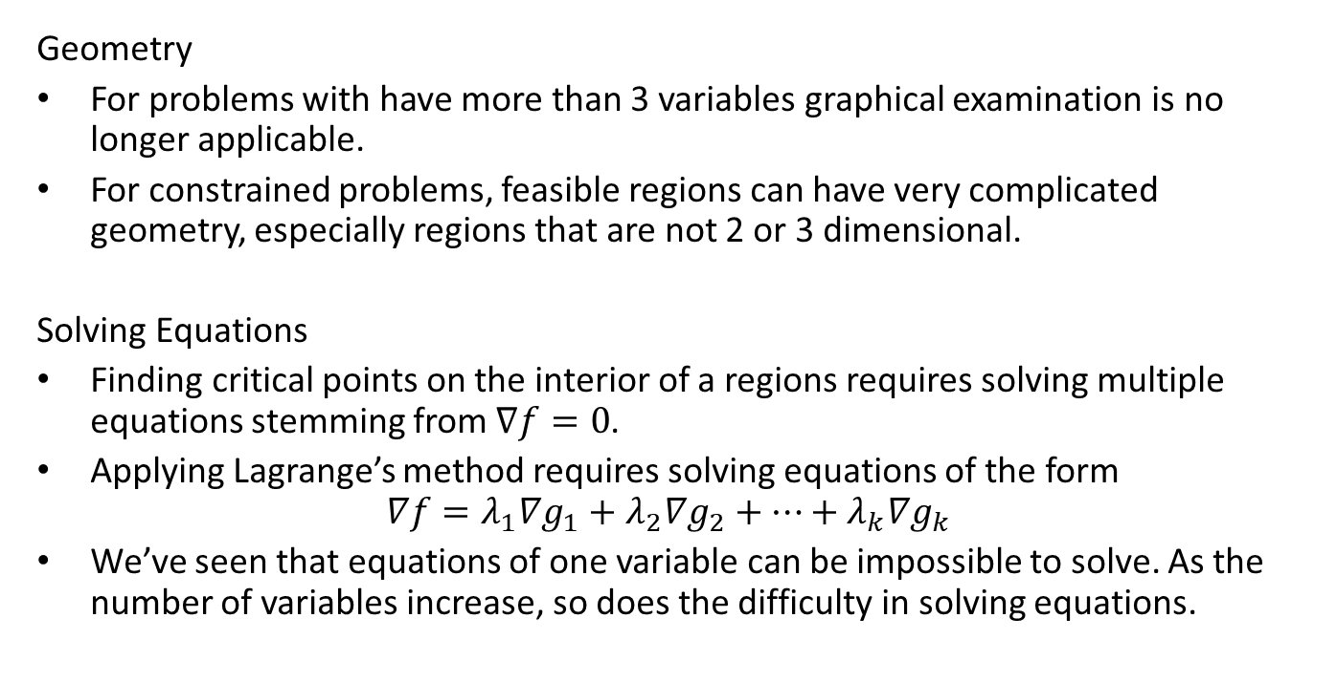
Issues with Multivariable Optimization
Geometry
For problems with have more than 3 variables graphical examination is no longer applicable.
For constrained problems, feasible regions can have very complicated geometry, especially regions that are not 2 or 3 dimensional.
Solving Equations
Finding critical points on the interior of a regions requires solving multiple equations stemming from $∇f=0$.
Applying Lagrange’s method requires solving equations of the form $∇f=λ_{1}∇g_{1}+λ_{2}∇g_{2}+⋯+λ_{k}∇g_{k}$
We’ve seen that equations of one variable can be impossible to solve. As the number of variables increase, so does the difficulty in solving equations.

Slide 3
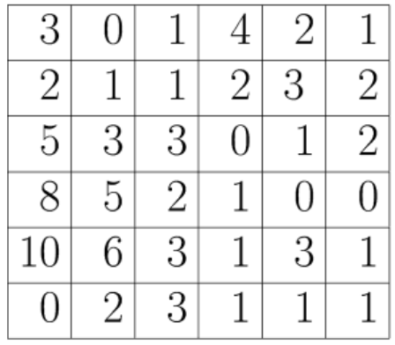
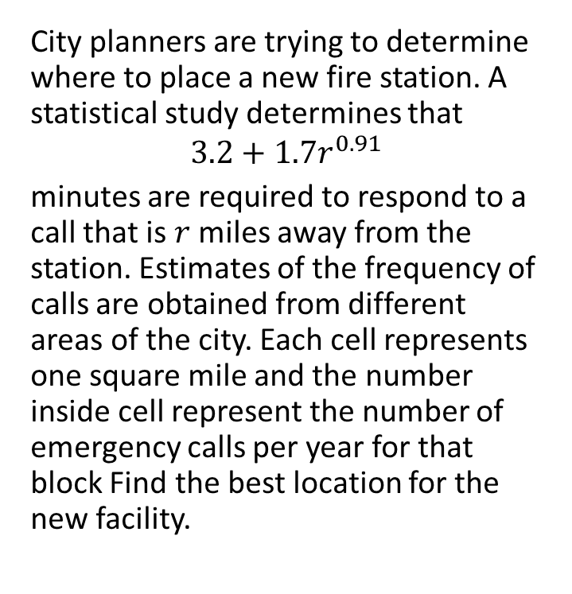
Example: A New Fire Station
City planners are trying to determine where to place a new fire station. A statistical study determines that
$$3.2+1.7r^{0.91}$$
minutes are required to respond to a call that is $r$ miles away from the station. Estimates of the frequency of calls are obtained from different areas of the city. Each cell represents one square mile and the number inside cell represent the number of emergency calls per year for that block Find the best location for the new facility.

Slide 4
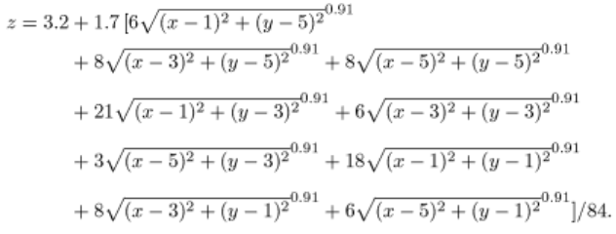
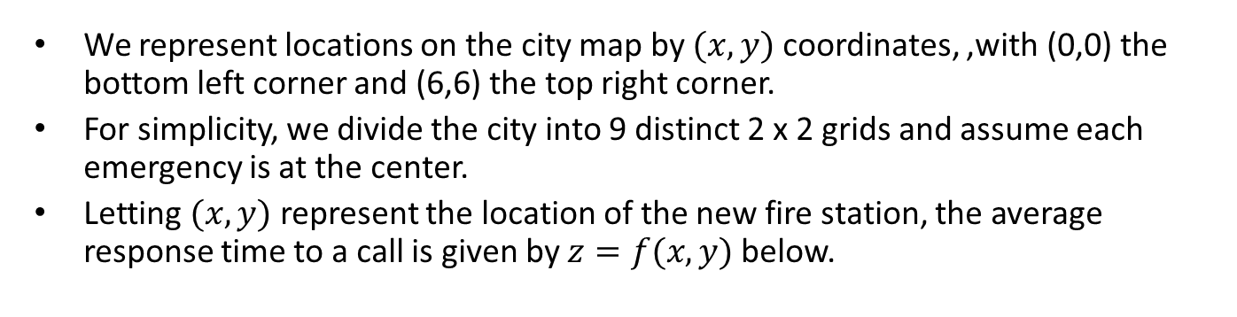
Example: A New Fire Station
We represent locations on the city map by $(x,y)$ coordinates, ,with (0,0) the bottom left corner and (6,6) the top right corner.
For simplicity, we divide the city into 9 distinct 2 x 2 grids and assume each emergency is at the center.
Letting $(x,y)$ represent the location of the new fire station, the average response time to a call is given by $z=f(x,y)$ below.
Notes:
84 total calls….the numbers in front the radical represent the sum of the contents of the 4 surrounding cells

Slide 5
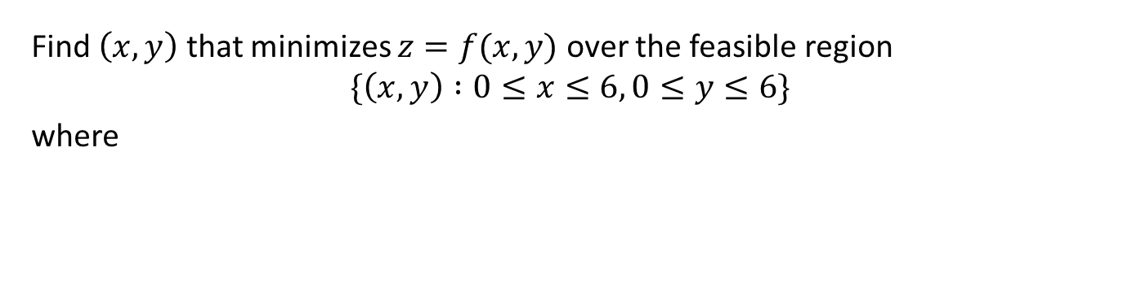
Example: A New Fire Station (Step 3)
Find $\left(x,y\right)$ that minimizes $z=f(x,y)$ over the feasible region
$$\{\left(x,y\right) :0≤x≤6, 0≤y≤6\}$$
where

Slide 6
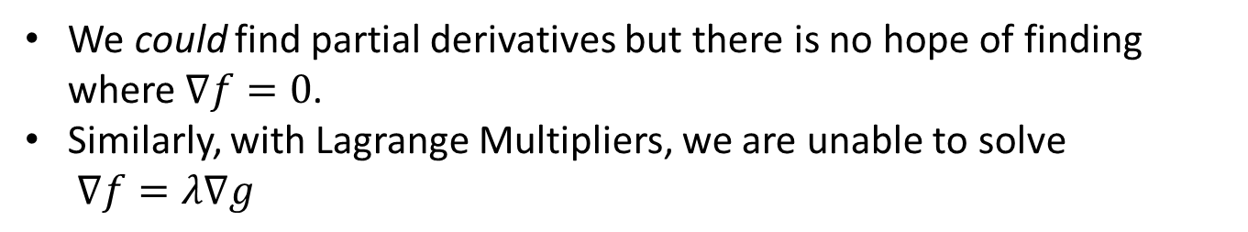
Example: A New Fire Station (Step 4)
Find $\left(x,y\right)$ that minimizes $z=f(x,y)$ over the feasible region
$$\{\left(x,y\right) :0≤x≤6, 0≤y≤6\}$$
where
We could find partial derivatives but there is no hope of finding where $∇f=0$.
Similarly, with Lagrange Multipliers, we are unable to solve $∇f=λ∇g$

Slide 7
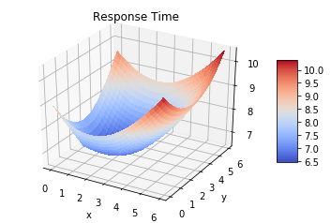
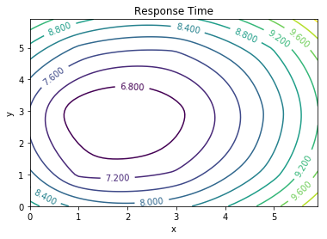
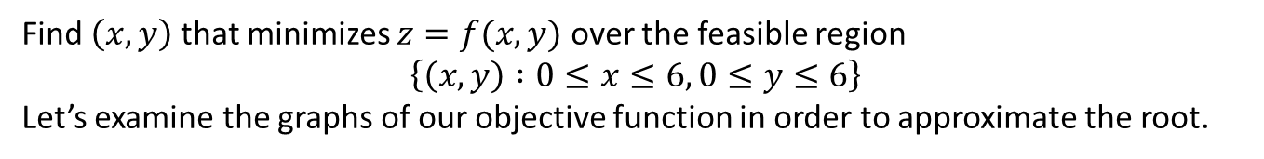
Graphical Approximation
Find $\left(x,y\right)$ that minimizes $z=f(x,y)$ over the feasible region
$$\left\{\left(x,y\right) :0≤x≤6, 0≤y≤6\right\}$$
Let’s examine the graphs of our objective function in order to approximate the root.
Notes:
Looks like the min is about 6.5 and this occurs at around x=2 and y = 3.
See python file section1-1pig.py

Slide 8
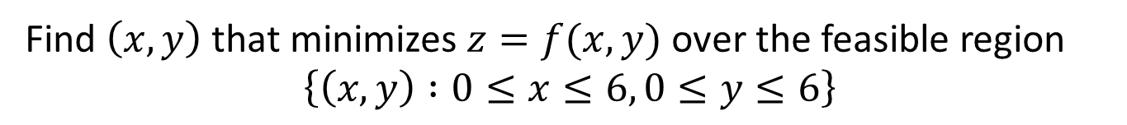
Approximating Solutions: Numerical Methods
Find $\left(x,y\right)$ that minimizes $z=f(x,y)$ over the feasible region
$$\left\{\left(x,y\right) :0≤x≤6, 0≤y≤6\right\}$$
There are several numerical methods to approximate solutions to equations such as this. Here is a non-comprehensive list:
Grid Search
Random Search
Newton’s Method (multivariable)
Nelder-Mead Method
Steepest Descent

Slide 9
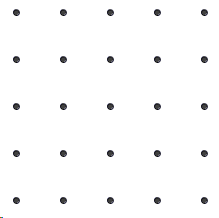
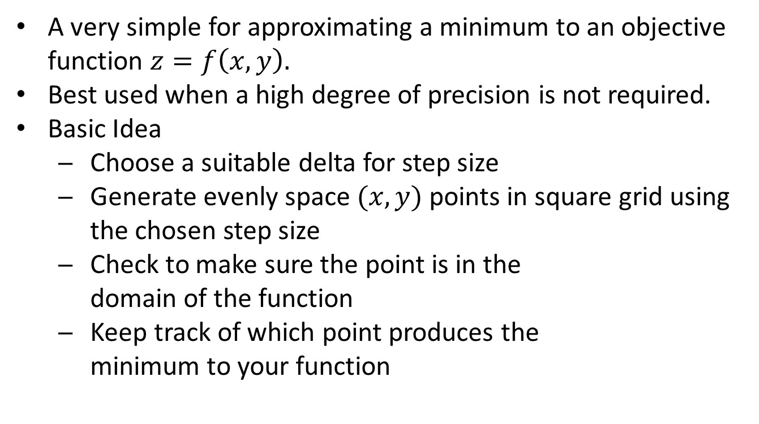
Grid Search Method
A very simple for approximating a minimum to an objective function $z=f\left(x,y\right).$
Best used when a high degree of precision is not required.
Basic Idea
Choose a suitable delta for step size
Generate evenly space $(x,y)$ points in square grid using the chosen step size
Check to make sure the point is in the domain of the function
Keep track of which point produces the minimum to your function

Slide 10
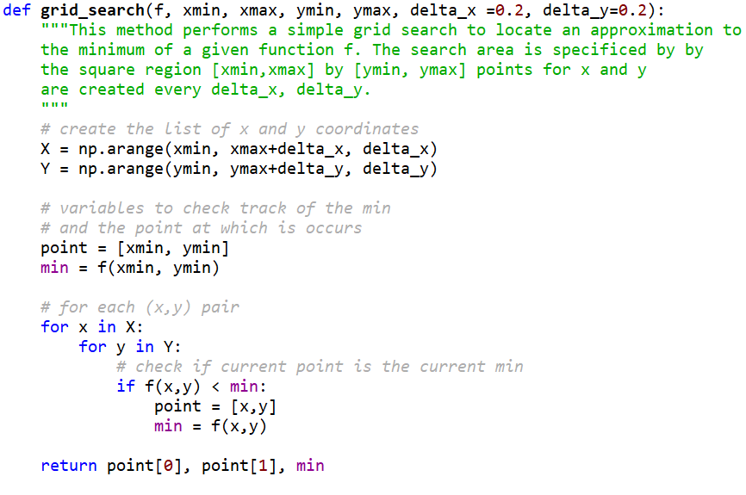
Grid Search Method

Slide 11
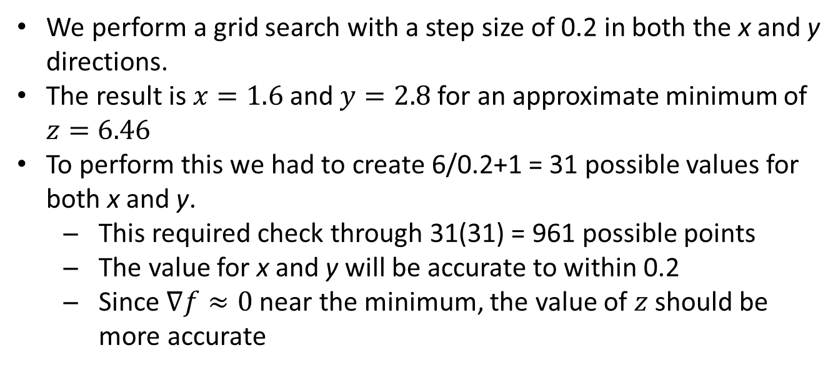
Approximating Solution: Grid Search
Find $\left(x,y\right)$ that minimizes $z=f(x,y)$ over the feasible region
$$\left\{\left(x,y\right) :0≤x≤6, 0≤y≤6\right\}$$
We perform a grid search with a step size of 0.2 in both the x and y directions.
The result is $x=1.6$and $y=2.8$for an approximate minimum of $z=6.46$
To perform this we had to create 6/0.2+1 = 31 possible values for both x and y.
This required check through 31(31) = 961 possible points
The value for x and y will be accurate to within 0.2
Since $∇f≈0$ near the minimum, the value of $z$ should be more accurate

Slide 12
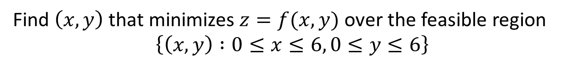
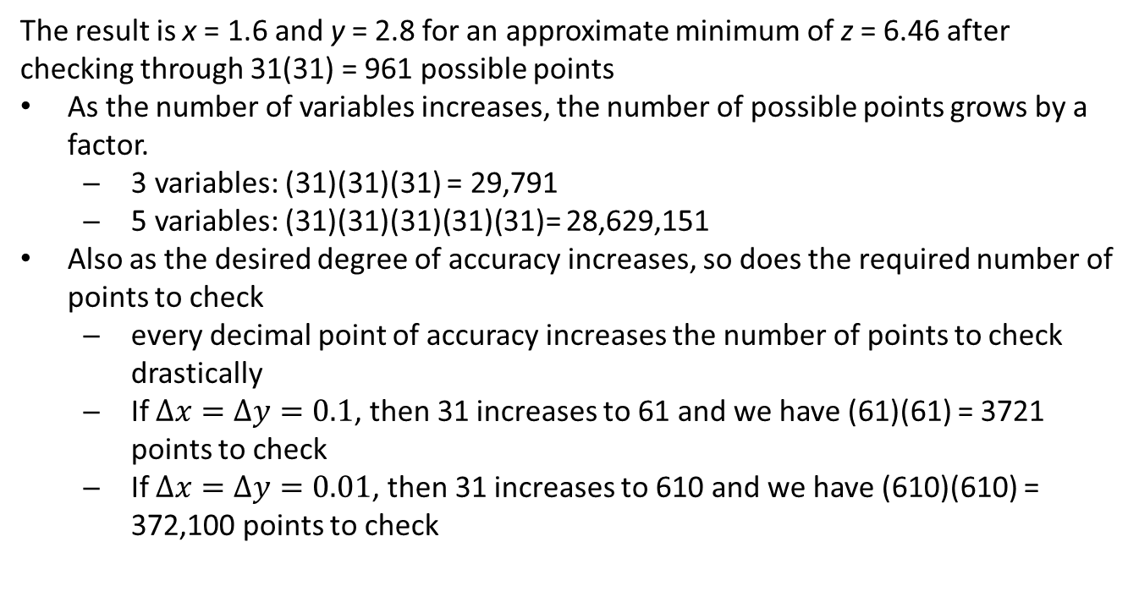
Approximating Solution: Grid Search
Find $\left(x,y\right)$ that minimizes $z=f(x,y)$ over the feasible region
$$\left\{\left(x,y\right) :0≤x≤6, 0≤y≤6\right\}$$
The result is x = 1.6 and y = 2.8 for an approximate minimum of z = 6.46 after checking through 31(31) = 961 possible points
As the number of variables increases, the number of possible points grows by a factor.
3 variables: (31)(31)(31) = 29,791
5 variables: (31)(31)(31)(31)(31)= 28,629,151
Also as the desired degree of accuracy increases, so does the required number of points to check
every decimal point of accuracy increases the number of points to check drastically
If $Δx=Δy=0.1$, then 31 increases to 61 and we have (61)(61) = 3721 points to check
If $Δx=Δy=0.01$, then 31 increases to 610 and we have (610)(610) = 372,100 points to check

Slide 13
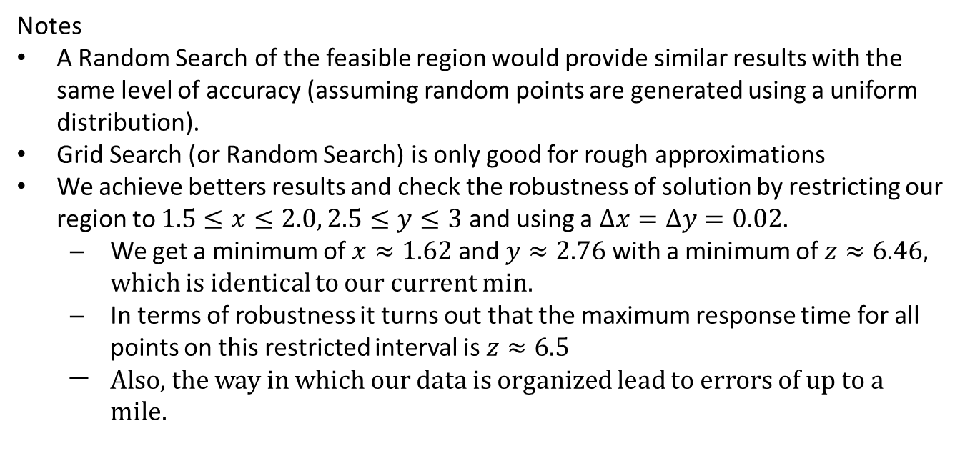
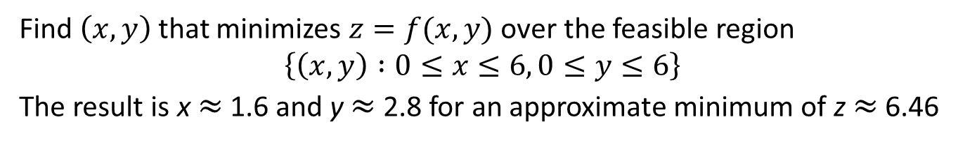
Approximating Solution: Grid Search
Find $\left(x,y\right)$ that minimizes $z=f(x,y)$ over the feasible region
$$\left\{\left(x,y\right) :0≤x≤6, 0≤y≤6\right\}$$
The result is x ≈ 1.6 and y ≈ 2.8 for an approximate minimum of z ≈ 6.46
Notes
A Random Search of the feasible region would provide similar results with the same level of accuracy (assuming random points are generated using a uniform distribution).
Grid Search (or Random Search) is only good for rough approximations
We achieve betters results and check the robustness of solution by restricting our region to $1.5≤x≤2.0, 2.5≤y≤3$ and using a $Δx=Δy=0.02$.
We get a minimum of $x≈1.62$ and $y≈2.76$ with a minimum of $z≈6.46$, which is identical to our current min.
In terms of robustness it turns out that the maximum response time for all points on this restricted interval is $z≈6.5$
Also, the way in which our data is organized lead to errors of up to a mile.

Slide 14
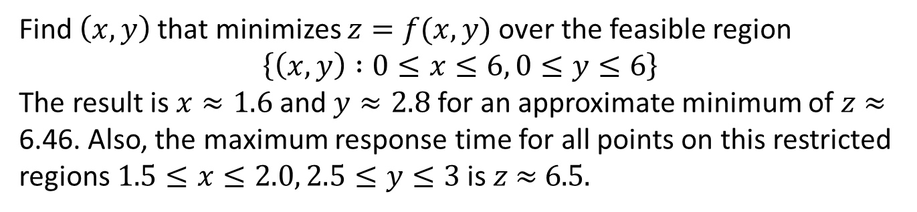
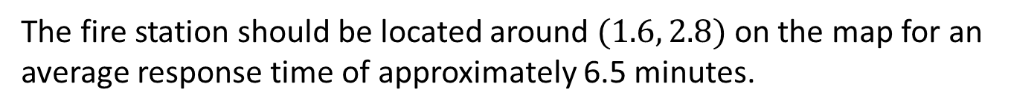
Example: Fire Station (Step 5)
Find $\left(x,y\right)$ that minimizes $z=f(x,y)$ over the feasible region
$$\left\{\left(x,y\right) :0≤x≤6, 0≤y≤6\right\}$$
The result is $x≈1.6$and $y≈2.8$ for an approximate minimum of $z$ ≈ 6.46. Also, the maximum response time for all points on this restricted regions $1.5≤x≤2.0, 2.5≤y≤3$ is $z$ ≈ 6.5.
The fire station should be located around $(1.6, 2.8)$on the map for an average response time of approximately 6.5 minutes.

Slide 15
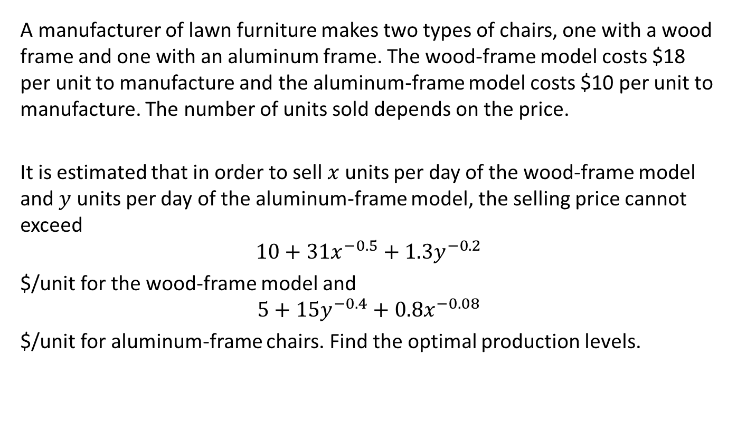
Example: Manufacturing Chairs
A manufacturer of lawn furniture makes two types of chairs, one with a wood frame and one with an aluminum frame. The wood-frame model costs $18 per unit to manufacture and the aluminum-frame model costs $10 per unit to manufacture. The number of units sold depends on the price.
It is estimated that in order to sell $x$ units per day of the wood-frame model and $y$ units per day of the aluminum-frame model, the selling price cannot exceed
$$10+31x^{−0.5}+1.3y^{−0.2}$$
$/unit for the wood-frame model and
$$5+15y^{−0.4}+0.8x^{−0.08}$$
$/unit for aluminum-frame chairs. Find the optimal production levels.

Slide 16
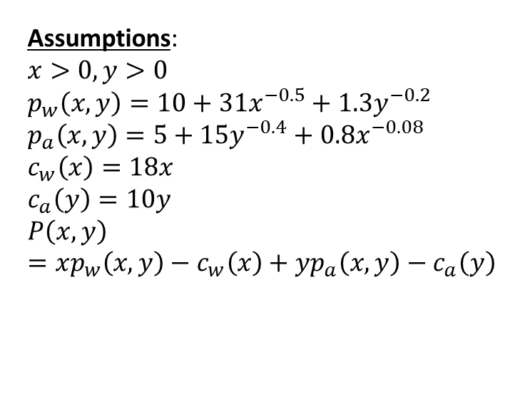
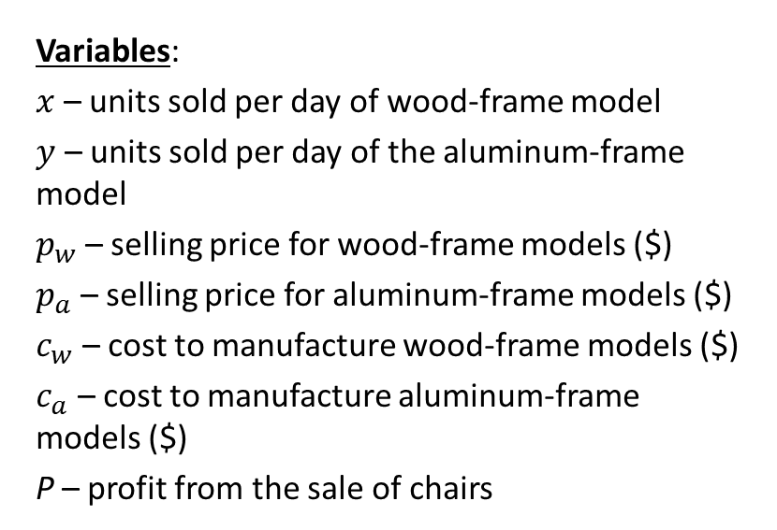
Example: Manufacturing Chairs (Step 1)
Variables:
$x$ – units sold per day of wood-frame model
$y$ – units sold per day of the aluminum-frame model
$p_{w}$ – selling price for wood-frame models ($)
$p_{a}$ – selling price for aluminum-frame models ($)
$c_{w}$ – cost to manufacture wood-frame models ($)
$c_{a}$ – cost to manufacture aluminum-frame models ($)
P – profit from the sale of chairs
Assumptions:
$$x>0, y>0$$
$$p_{w}\left(x,y\right)=10+31x^{−0.5}+1.3y^{−0.2}$$
$$p_{a}\left(x,y\right)=5+15y^{−0.4}+0.8x^{−0.08}$$
$$c_{w}\left(x\right)=18x$$
$$c_{a}\left(y\right)=10y$$
$$P\left(x,y\right)=xp_{w}\left(x,y\right)−c_{w}\left(x\right)+yp_{a}\left(x,y\right)−c_{a}\left(y\right)$$
Parameters:
$10 – cost per unto to manufacture aluminum-frame model
$18 – cost per unto to manufacture wood-frame model

Slide 17
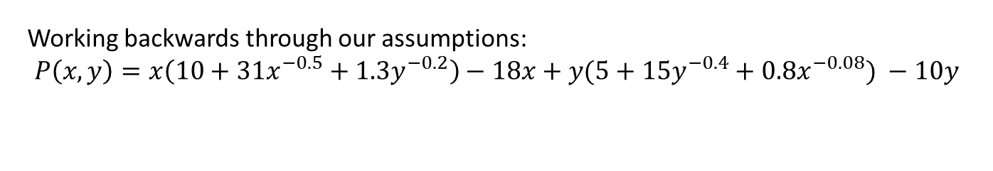
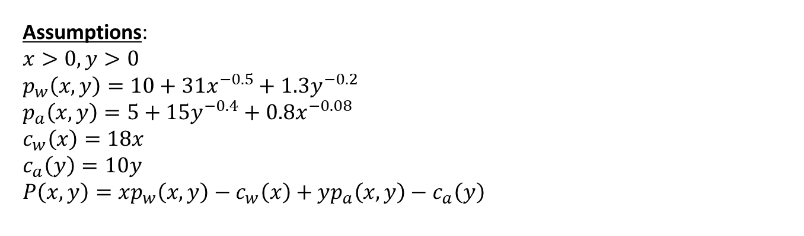
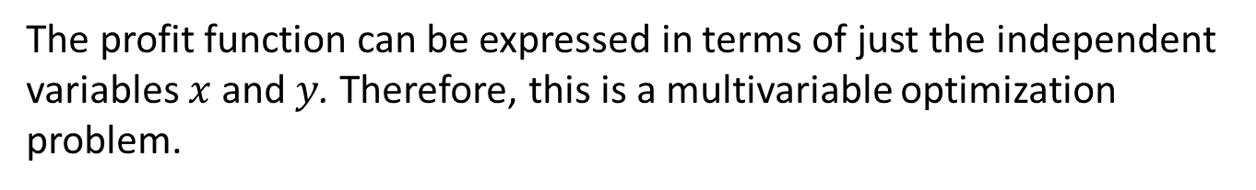
Step 2: Select the modeling approach
Assumptions:
$$x>0, y>0$$
$$p_{w}\left(x,y\right)=10+31x^{−0.5}+1.3y^{−0.2}$$
$$p_{a}\left(x,y\right)=5+15y^{−0.4}+0.8x^{−0.08}$$
$$c_{w}\left(x\right)=18x$$
$$c_{a}\left(y\right)=10y$$
$$P\left(x,y\right)=xp_{w}\left(x,y\right)−c_{w}\left(x\right)+yp_{a}\left(x,y\right)−c_{a}\left(y\right)$$
Working backwards through our assumptions:
$$P\left(x,y\right)=x\left(10+31x^{−0.5}+1.3y^{−0.2}\right)−18x+y(5+15y^{−0.4}+0.8x^{−0.08}) −10y$$
The profit function can be expressed in terms of just the independent variables $x$ and $y$. Therefore, this is a multivariable optimization problem.

Slide 18

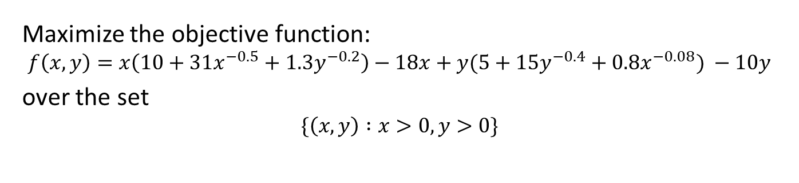
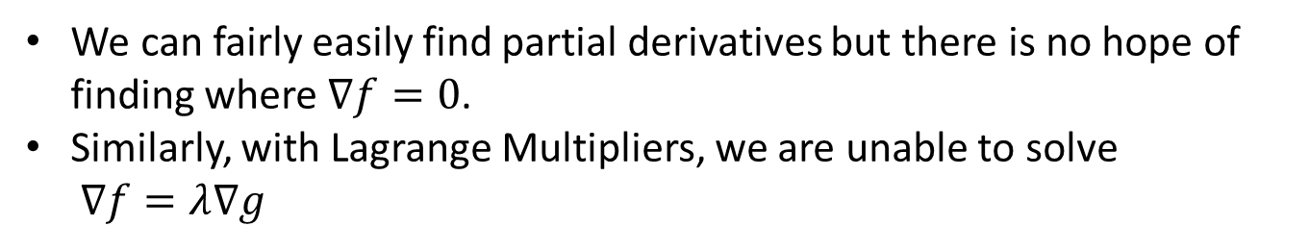
Step 3: Formulate the Model
Maximize the objective function:
$$f\left(x,y\right)=x\left(10+31x^{−0.5}+1.3y^{−0.2}\right)−18x+y(5+15y^{−0.4}+0.8x^{−0.08}) −10y$$
over the set
$$\{\left(x,y\right) :x>0,y>0\}$$
We can fairly easily find partial derivatives but there is no hope of finding where $∇f=0$.
Similarly, with Lagrange Multipliers, we are unable to solve ∇$f=λ$∇$g$

Slide 19
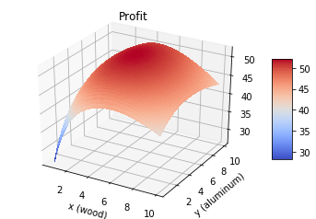
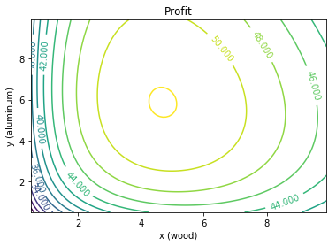
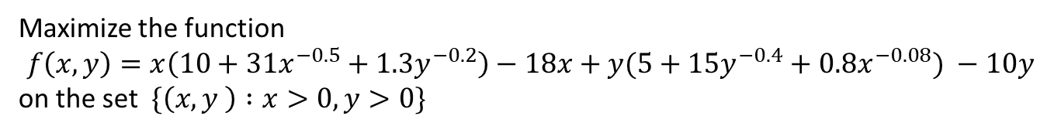
Solve the Problem (Global Approx.)
Maximize the function
$$f\left(x,y\right)=x\left(10+31x^{−0.5}+1.3y^{−0.2}\right)−18x+y(5+15y^{−0.4}+0.8x^{−0.08}) −10y$$
on the set $\{\left(x,y \right) :x>0,y>0\}$
Let’s examine the graphs of our objective function in order to approximate the root.
Based on the graphs it appears that the maximum is over 50 and around (4.5, 6).
Notes:
See python file section1-1pig.py

Slide 20
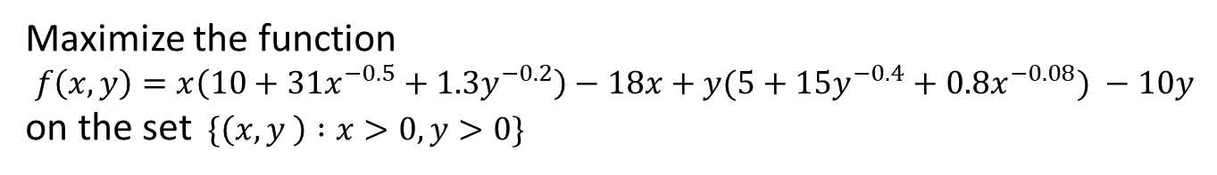
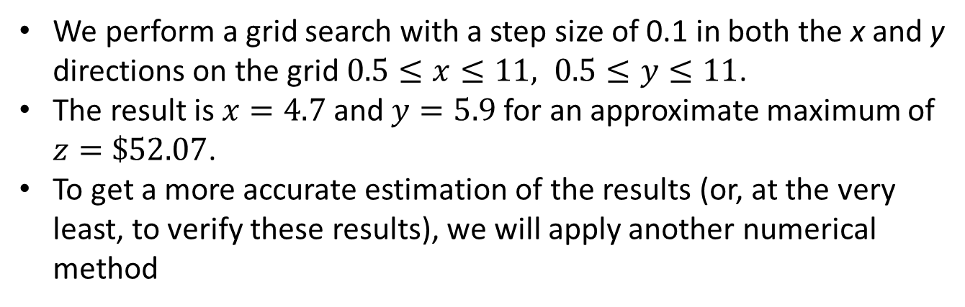
Approximating Solution: Grid Search
Maximize the function
$$f\left(x,y\right)=x\left(10+31x^{−0.5}+1.3y^{−0.2}\right)−18x+y(5+15y^{−0.4}+0.8x^{−0.08}) −10y$$
on the set $\{\left(x,y \right) :x>0,y>0\}$
We perform a grid search with a step size of 0.1 in both the x and y directions on the grid $0.5≤x≤11, 0.5≤y≤11$.
The result is $x=4.7$and $y=5.9$ for an approximate maximum of $z=\$52.07$.
To get a more accurate estimation of the results (or, at the very least, to verify these results), we will apply another numerical method

Slide 21
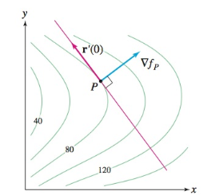
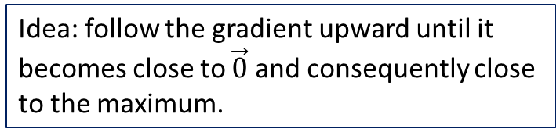
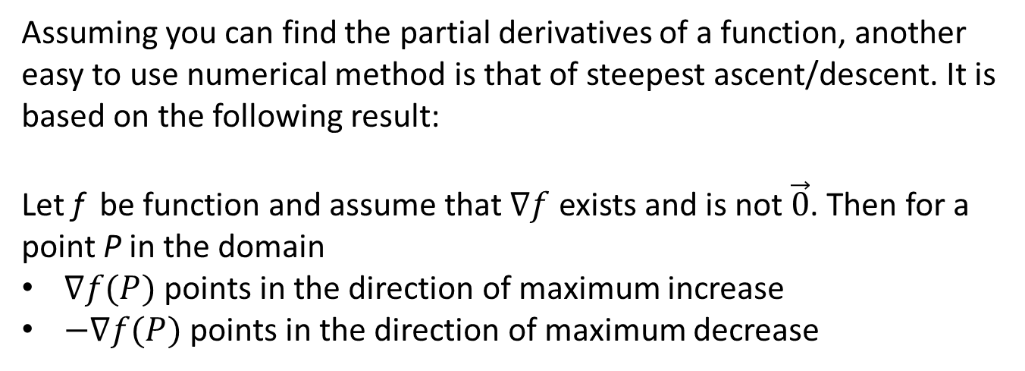
Steepest Ascent
Assuming you can find the partial derivatives of a function, another easy to use numerical method is that of steepest ascent/descent. It is based on the following result:
Let f be function and assume that $∇f$ exists and is not $\vec{0}$. Then for a point P in the domain
$∇f(P)$points in the direction of maximum increase
$−∇f(P)$points in the direction of maximum decrease
Idea: follow the gradient upward until it becomes close to $\vec{0}$ and consequently close to the maximum.

Slide 22
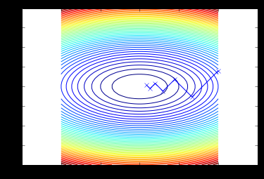
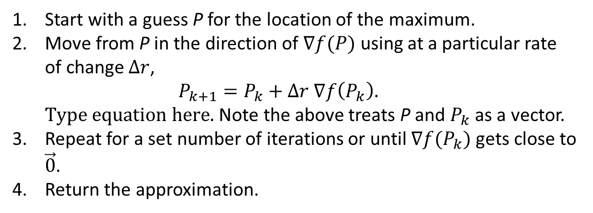
Steepest Ascent
Start with a guess P for the location of the maximum.
Move from P in the direction of $∇f(P)$using at a particular rate of change $Δr$, $P_{k+1}=P_{k}+Δr ∇f\left(P_{k}\right).$ Note the above treats P and $P_{k}$ as a vector.
Repeat for a set number of iterations or until $∇f(P_{k})$ gets close to $\vec{0}$.
Return the approximation.

Slide 23
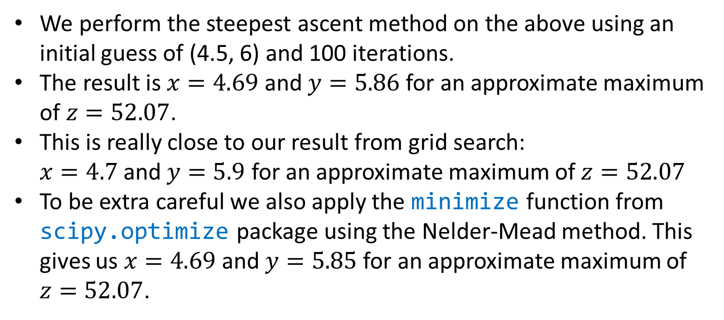
Approximating Solution: Steepest Ascent
Maximize the function
$$f\left(x,y\right)=x\left(10+31x^{−0.5}+1.3y^{−0.2}\right)−18x+y(5+15y^{−0.4}+0.8x^{−0.08}) −10y$$
on the set $\{\left(x,y \right) :x>0,y>0\}$
We perform the steepest ascent method on the above using an initial guess of (4.5, 6) and 100 iterations.
The result is $x=4.69$and $y=5.86$ for an approximate maximum of $z=52.07$.
This is really close to our result from grid search: $x=4.7$and $y=5.9$ for an approximate maximum of $z=52.07$
To be extra careful we also apply the minimize function from scipy.optimize package using the Nelder-Mead method. This gives us $x=4.69$ and $y=5.85$for an approximate maximum of $z=52.07$.

Slide 24
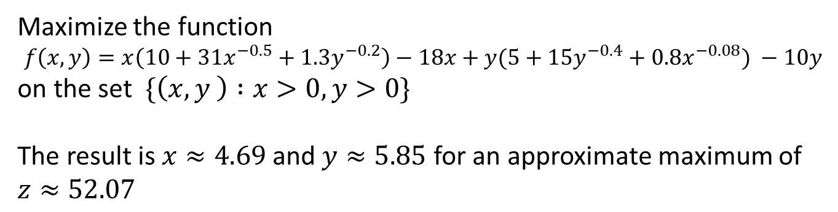
Example: Chair Manufacturing (Step 5)
Maximize the function
$$f\left(x,y\right)=x\left(10+31x^{−0.5}+1.3y^{−0.2}\right)−18x+y(5+15y^{−0.4}+0.8x^{−0.08}) −10y$$
on the set $\{\left(x,y \right) :x>0,y>0\}$
The result is $x≈4.69$ and $y≈5.85$ for an approximate maximum of $z≈52.07$
Conclusion: The optimal solution to the chair problem is to produce 4.69 wood-frame chairs and 5.85 aluminum-frame chairs per day, which should result in a profit of $52.07 per day.

Slide 25
Notes
The accurate numerical solution of systems of equations is a two-step process
Use a global method like graphing to estimate the location of a solution
When graphing is not possible use a random or grid search to begin your estimation
After your first estimation, use numerical method to find more accurate results
Remember to use caution with numerical methods; always verify your results
The methods discussed in this section are mostly applicable when the solution is on the interior of the feasible region or there are no constraints (unbounded problem).
Problems where the solution falls on the boundary can be very difficult
There is no “best” numerical method to solve these problems.
Some types of these problems have solutions
For many it is a matter of trial and error (and patience and practice)

